Slide 1

Guardianship and Surety Bonds

Slide 2
Agenda
Basics of Surety v. Insurance
Surety Bond Underwriting
Understanding the Indemnity Agreement and your responsibilities to the Surety
When are Bonds Required?
Bond Premiums and Best Practices
What happens when…Bonds Q&A

Slide 3
Surety vs. Insurance
-Surety Bonds are essentially the opposite of Insurance.
-In Surety, there are three parties: the Principal (Guardian) the Surety and the Obligee (the Ward and their interested parties). The surety is guaranteeing the performance of the Principal to the Obligee. Each Surety bond is underwritten based on the chance of loss or risk.
- In Insurance, the Insured is protected from loss by the insurance company. This is based on the principal of the “Law of Large Numbers” where an entire class of risk is selected with the idea that the majority will pay for the losses.

Slide 4
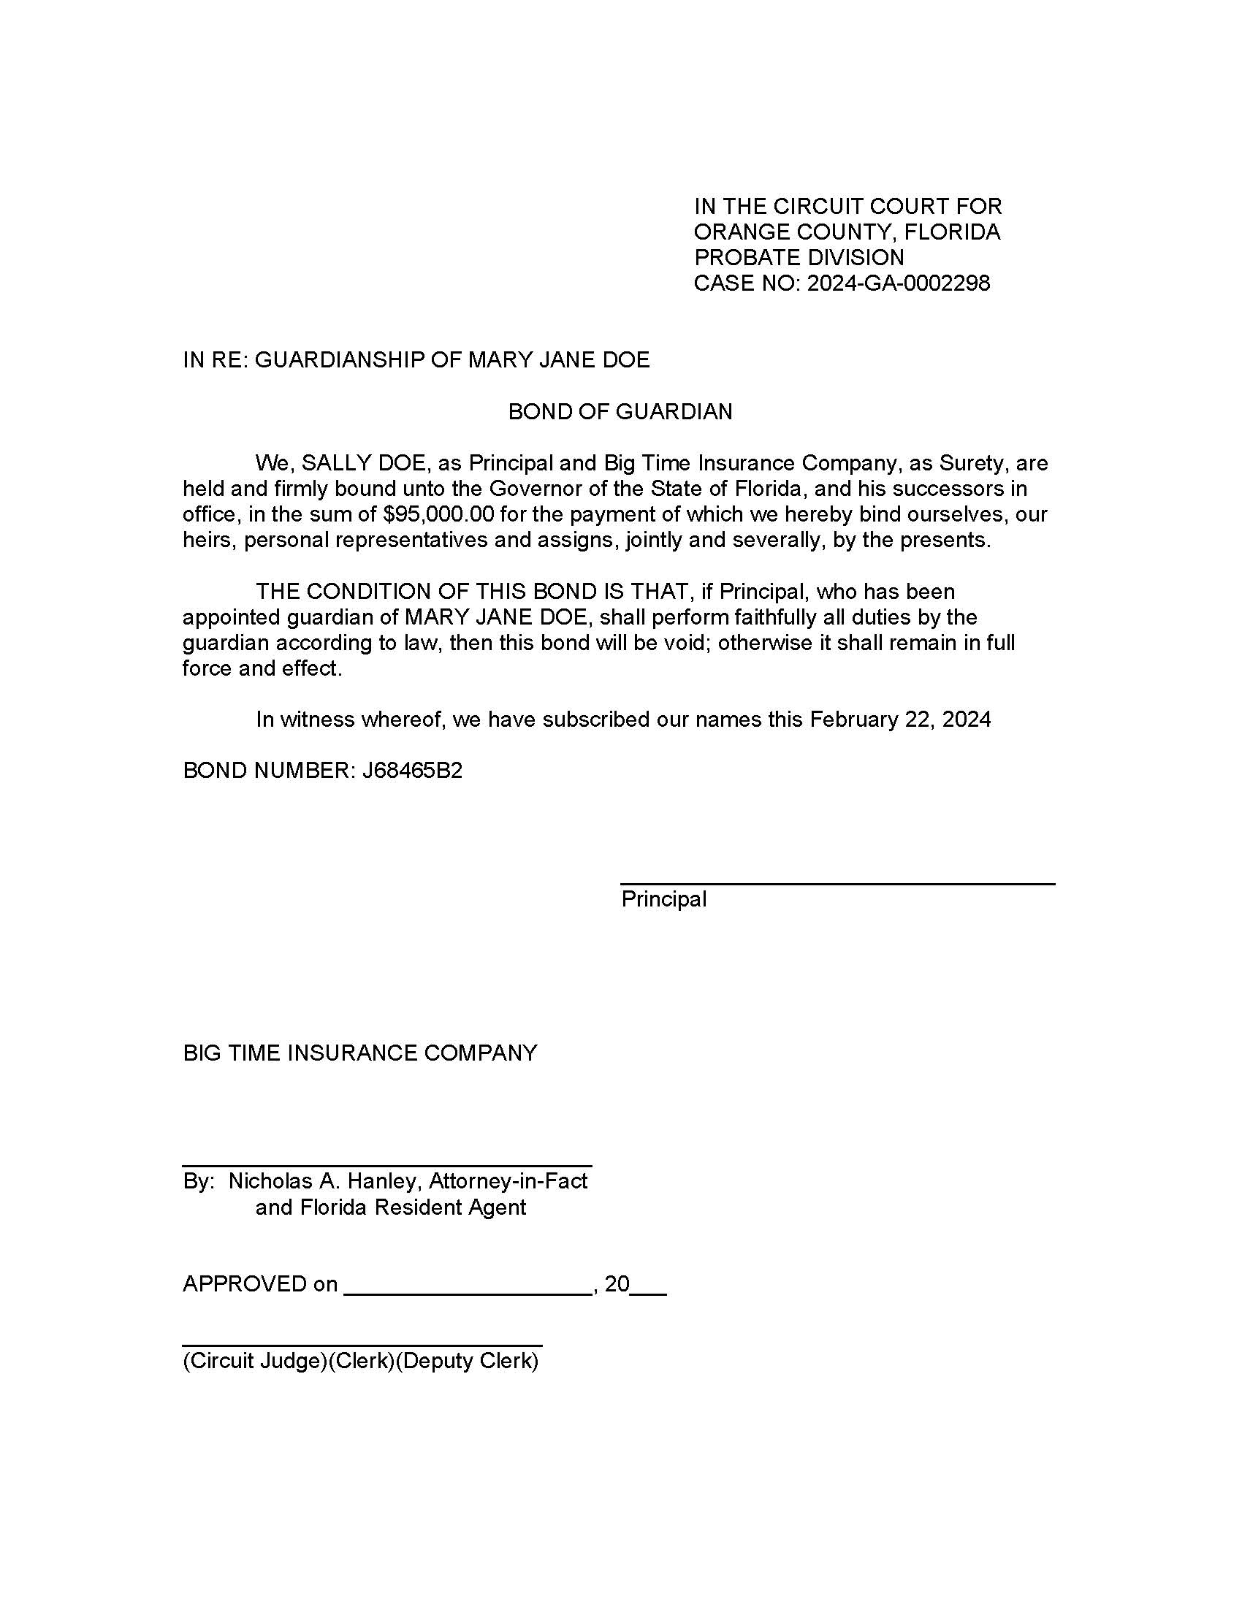
Here is a bond form

Slide 5
Surety Bond Underwriting
The purpose of Underwriting is to ensure the applicant is creditworthy and that the case is low in Risk.
  Credit Report and Financial Statement
  Review of the case
  Attorney Credentials

Slide 6
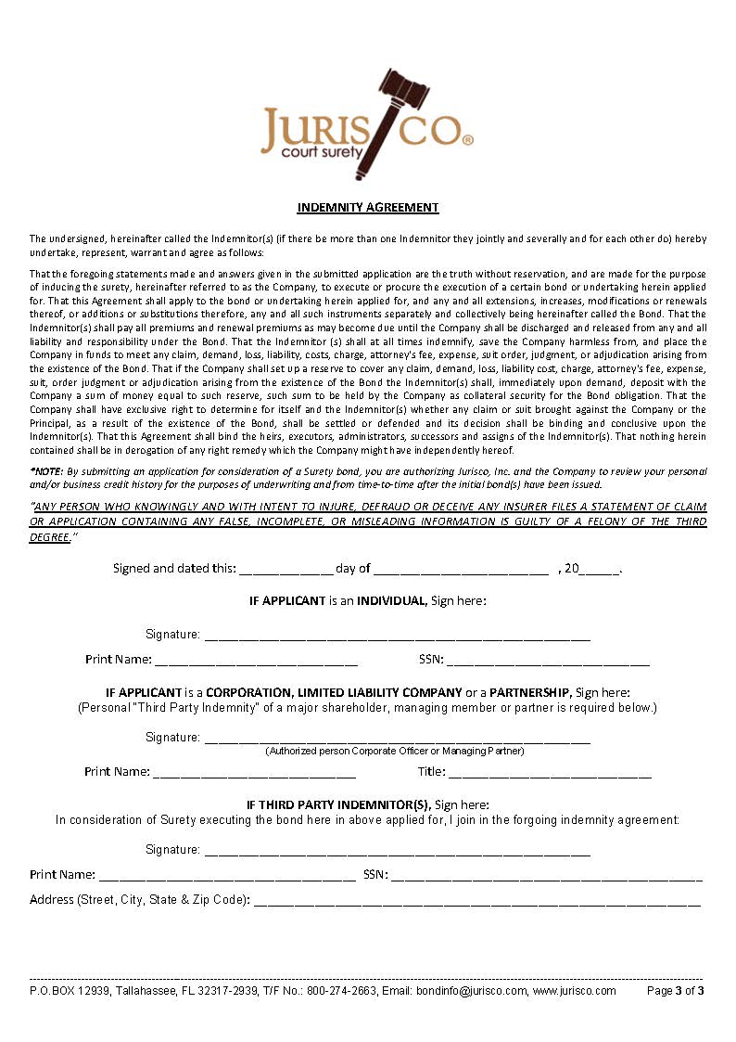
Indemnity Agreements- The Cornerstone of Surety Bonds
- Indemnity Agreements give the surety the right to be repaid in the event of a Loss and to collect bond premiums.
- If a claim occurs, the surety will contact the bond principal to post a reserve to pay the claim.
- In the event the surety must sue the bond Principal, this is the legal document at the heart of their suit.

Slide 7


When are Bonds Required?
- Professional Guardian License bonds are required by the FL Statute and regulated by the Office of Public and Professional Guardian. You can additionally obtain a larger bond to become a National Guardian or other designation.
- Bonds for Individual Wards will be set by the court. Some counties require bonds, others don’t.
- The VA requires bonds in all veteran custodianships where assets exceed $20k and a bond is not posted in the court guardianship.

Slide 8
Bond Premiums Best Practices
- Bond premiums are to be paid annually until the court issues an “Order of Discharge” or other order releasing the Surety from Liability.
- The court requires the bond so they expect it to be paid from the Guardianship Account.
- Even in the case where the ward dies and there is no Discharge you should pay the premium. If you release the funds to the estate and there are premiums due you will be personally responsible for payment!!!
- Each year when you file your accounting, if the assets have decreased you can file a Petition to Reduce the Bond. You will provide this to the surety to amend the premium pro-rata.

Slide 9

Thank you!!!
Alex Hanley
Jurisco, Inc.
a.hanley@jurisco.com
850-422-3655

