Slide 1
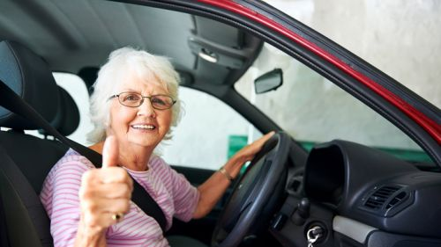
Empowering Guardians: Navigating Occupational Therapy and Older Adult Driving
By: Jital Patel, OTR/L, CFPS, DRP
July 27, 2023

Slide 2
BABY BOOMERS
Baby boomer generation living longer and being more active
Most mobile generation to date
Expect to remain mobile in the community as they age

Slide 3
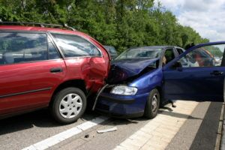
Motor vehicle injuries persist as the leading cause of injury-related deaths
The second leading cause (after falls)
Expected massive increase in the number of older adults on the road is certain to lead to increased injuries and deaths

Slide 4
Crashes among older adult drivers:
errors of inattention or slowed speed of visual processing.
multiple-vehicle, lower-speed events that occur at intersections
involve left-hand turns
include inadequate surveillance and difficulties judging the speed of other vehicles and the space available

Slide 5
Healthcare practitioners and anyone caring for older adults…
we are in a LEADING position to address and correct this public health concern at the individual patient and caregiver level.

Slide 6
OCCUPATIONAL THERAPY: ENHANCING INDEPENDENCE

Slide 7
Common Challenges Faced by Older Adults in Maintaining Independence
Physical Limitations
Strength, flexibility, balance
Cognitive Limitations
Memory loss, reduced attention, and slower processing speed
Emotional Well-being
loneliness, anxiety, or depression
Chronic Health Conditions
arthritis, diabetes, or heart disease

Slide 8
OT & DRIVING
Driving and community mobility are IADLs
can evaluate for functional ability essential to driving
also provide recommendations for vehicles
can provide intervention and strategies to be able to drive
*supported by our national organization to address driving.

Slide 9
DRIVERS LICENSE = INDEPENDENCE

Slide 10
Assessing Driving Abilities
Physical Challenges
reduced Mobility, Slower Reaction Time, Difficulty with Pedals
Sensory Impairments
Vision Changes, Hearing Loss
Cognitive Changes
Memory Issues, Attention and Concentration, Decision-Making
Increased Anxiety or Fear
Avoidance Behavior
Deteriorating Confidence

Slide 11
“Is the older adult at increased risk of unsafe driving?”
Clinical observation of the older adult
Identifying red flags
-cognitive and physical conditions
-symptoms associated with chronic illnesses
-medications that may impair safe driving
-new-onset driving behaviors that may indicate declining traffic skills

Slide 14
DRIVING SCREEN OR ASSESSMENT
Primary message = concern and assistance
Avoid an adversarial position
Begin with a commitment to explore all options
Screening and assessment are necessary to identify ways to help

Slide 15
The goal of the assessment is to facilitate driving safety among older adults and assure that those who can drive safely are helped to do so for as long as possible.

Slide 16
Process of Screening and Referral
Medical impairments affect driving
Utilize screening/assessment tools
Driving is primary mode of transportation

Slide 17
SELF ASSESSMENT TOOLS
Drivers 65 Plus: Check your performance
The Fitness to Drive Screening Measure
https://ftds.phhp.ufl.edu/us/

Slide 19
Health care professionals with special training in driver rehabilitation who offer driving evaluations both in an office and in a vehicle. This allows them to assess your physical, visual, and cognitive abilities as a driver.

Slide 20
OT-DRS Comprehensive Driving Evaluation
Involves 3 primary components:
1. Occupational Profile
History, current situation, the individual’s goals
The importance of driving to the individual
2. Administration, scoring and interpretation of clinical tests, evidence-
based measures of driving capacity
3. Functional on-road test where skills are observed in context

Slide 21
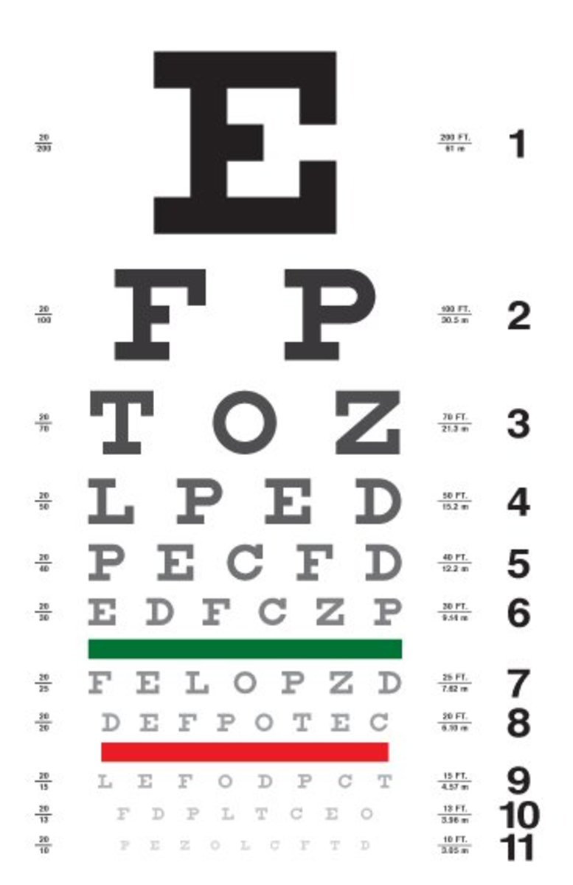
VISION SCREEN
Visual Acuity
Visual Fields and Neglects
Depth Perception
Night Vision
Glare Recovery
Contrast Sensitivity

Slide 22
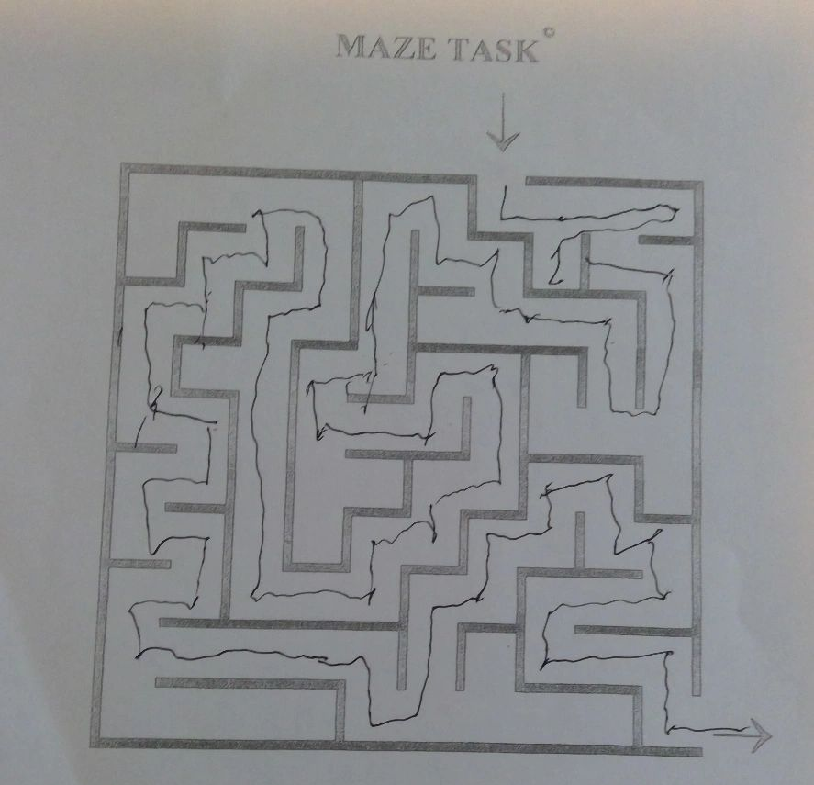
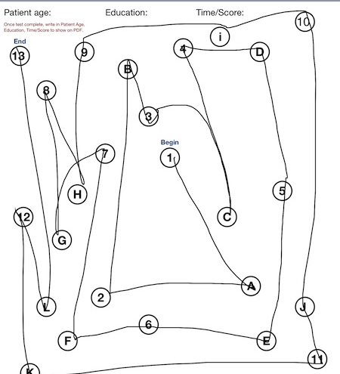
EVIDENCE BASED TOOLS
Visual Spatial, Executive Function, Semantic Memory
Memory, Orientation, Concentration
Attention, Executive Function

Slide 23
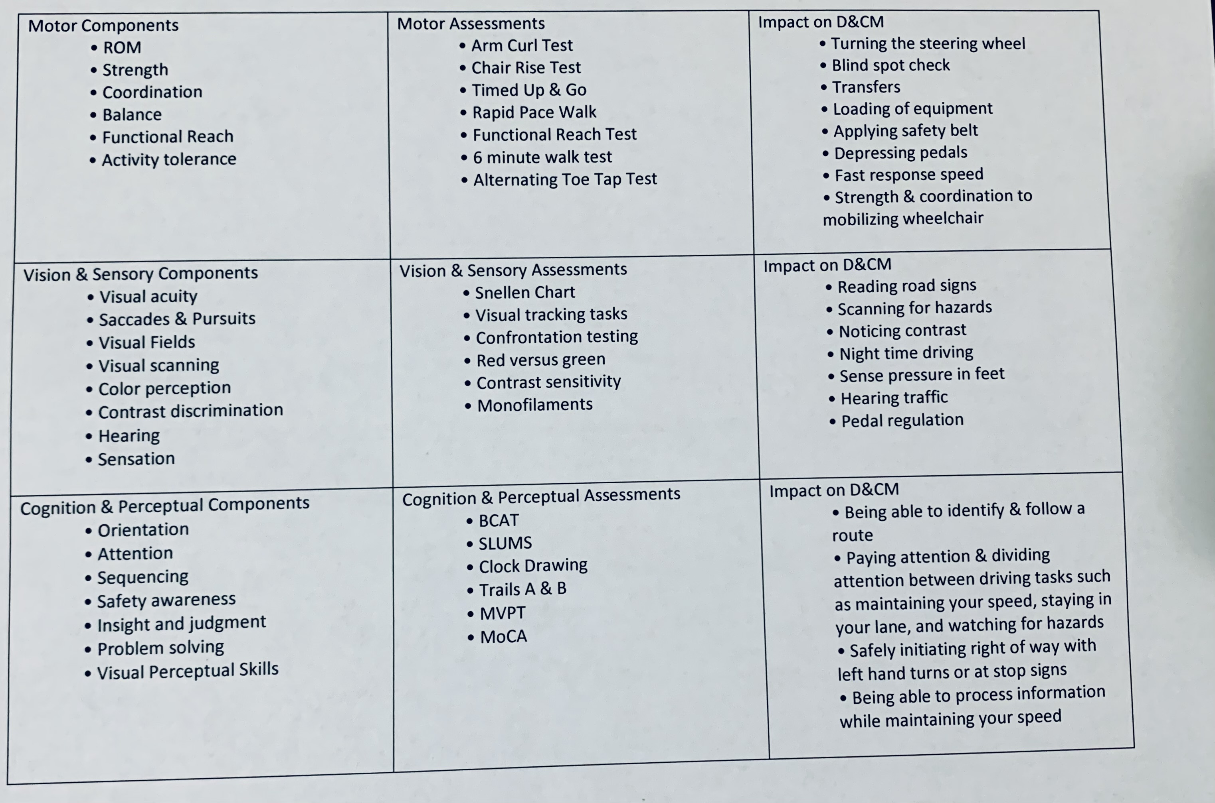
TESTS & MEASURES FOR
DRIVING & COMMUNITY MOBILITY

Slide 24
Behind-the-Wheel Assessment (*only performed if the driver demonstrated the minimum physical, visual, and cognitive abilities necessary for safe driving during the clinical evaluation.)
Operational
Using Controls
Lane Positioning
Visual Scanning
Lane Changes
Tactical
Attending to signs
Speed/Reaction Time
Complex Intersections
Rules of the Road
Strategic
Self Directed Driving
Problem solving (return to…)
Road construction?

Slide 25
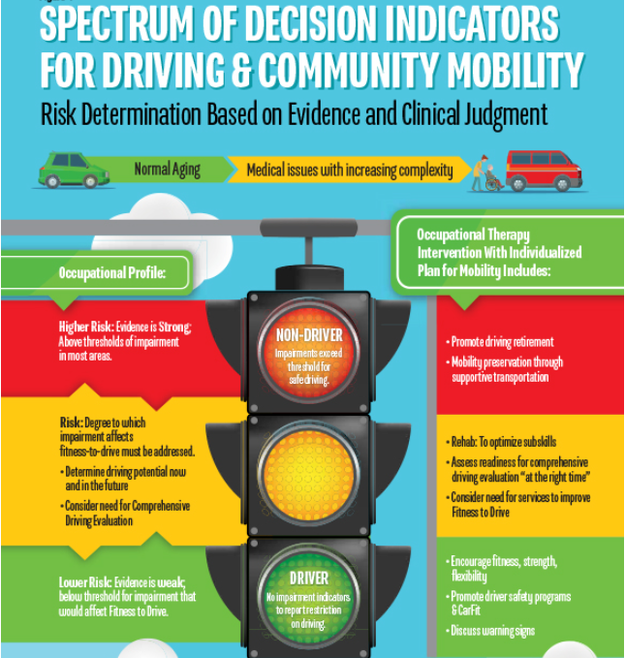

Slide 27
EARLY TRANSPORTATION PLANNING
How much do rides cost?
What method is used to charge for rides? Is it calculated by mileage or by time?
How far in advance you need to make a reservation?
Are the vehicles accessible if you use a wheelchair or walker?
Will drivers help you in or out of the car if you need assistance or have packages?
What areas do the cars serve? Is there a maximum distance a driver will take you?
Are drivers properly licensed, insured, and checked by appropriate agencies?
Do drivers use their own vehicles? If so, are they properly inspected, registered and insured? Do they have safety belts and other safety features?
It’s crucial to maintain independence by creating alternative transportation solutions.

Slide 28
RESOURCES
Clinician’s Guide to Assessing and Counseling Older Drivers, 3rd Edition
https://www.nhtsa.gov/sites/nhtsa.gov/files/812228_cliniciansguidetoolderdrivers.pdf
AMERICAN OCCUPATIONAL THERAPY ASSOCIATION – DRIVING & COMMUNITY MOBILITY
https://www.aota.org/practice/clinical-topics/driving-community-mobility
WORLDS LARGEST PROVIDER FOR DRIVING REHAB EDUCATION – FIND A SPECIALIST
https://www.aded.net/default.aspx
SENIOR TRANSPORTATION MOBILITY PLANNER
https://exchange.aaa.com/wp-content/uploads/2021/03/Senior-Transportation-Mobility-Planner.pdf
WHAT TO EXPECT WHEN REFERRED TO DRIVING REHAB SPECIALIST
https://www.roadsafeseniors.org/sites/default/files/resources/document/What_To-Expect_Referred_DRS_Handout.pdf
EYE CARE FOR OLDER ADULTS
https://www.aao.org/education/eye-care-for-older-adults
DEMENTIA & DRIVING
https://www.alz.org/help-support/caregiving/safety/dementia-driving
ORGANIZATION THAT PROVIDES INSTRUCTION AND TESTING FOR OLDER DRIVERS https://www.nhtsa.gov/road-safety/older-drivers
Teen Drivers https://www.nhtsa.gov/road-safety/teen-driving
Adaptive Vehicles https://www.nhtsa.gov/road-safety/adapted-vehicles
Older Drivers https://www.nhtsa.gov/road-safety/older-drivers
DRIVERS 65 PLUS: SELF-RATING TOOL
https://exchange.aaa.com/wp-content/uploads/2021/03/Driver-65-Plus.pdf
EVIDENCE-BASED CONSENSUS STATEMENTS FOR DRIVING AND COMMUNITY MOBILITY
Foster Occupational Therapy Engagement in Older Drivers: Addressing Gaps through Pathways NHTSA Cooperative Agreement Number: DTNH22-11-H-00340 Expert Consensus Statements. 2015
https://www.aota.org/~/media/Corporate/Files/Practice/Aging/Driving/evidence-basedconsensus-statements-driving-community-mobility.pdf

Slide 29
THANK YOU!
Jital Patel, OTR/L, CFPS, DRP
Coastal Occupational Therapy
Office: (321) 361-8040
Email: admin@coastaltherapyFL.com
Website: www.coastaltherapyFL.com
IG: drive_ability
FB: coastaloccupationaltherapy

