Slide 1
ABLE Accounts
ABLE United – Florida’s Disability Savings Program
Notes:
LEAD: Steph
Well, good afternoon, everyone, and welcome to Key Benefits and Updates to ABLE United: Florida’s Disability Savings Program.
​
My name is Steph Conti, and I serve as the Spokesperson for ABLE United, Florida’s qualified ABLE program. I’m joined by ABLE United Director, John Finch. John?​
​
We’d like to thank the Academy of Elder Law Attorneys for collaborating with us again on this very important topic that has the opportunity to impacts thousands of Floridians of disabilities. We also want to thank all of you for registering and being apart of today’s free CLE opportunity.​ For those of you that joined us last year, welcome back, and for those new to ABLE accounts, we look forward to you becoming advocates of our program.
​
Before we get started, we’d like to open the floor up to Jason Neufeld, Education Chair, to say a few words. ​
​
Thank you, Jason.​
​
Well, in the essence of time, let’s get right to it.
Recorded – questions

Slide 2
ABLE Outline
History and Legislation
Program Management for Florida
Eligibility and Enrollment
How It Works with Public Benefits
ABLE Accounts and Special Needs Trusts
Death of Beneficiary
Hypothetical Situations
How to Reach Us
Notes:
LEAD: Steph
Here’s a quick snapshot of what we’ll cover today during our time together: ​
​
History and Legislation
Program Management for Florida and be able to list the differences between other state run programs
Eligibility and Enrollment will help you identify who is eligible
How it Work with Public Benefits
Explain the differences between ABLE Accounts and Special Needs Trusts
Death of Beneficiary
Hypothetical situations
contact
​
And lastly – questions. If you have questions at any point in time, please be sure to put them in the Questions box. John and I will be reviewing them in real-time and also leave time after the presentation to answer a few. ​We are also recording this session and will send you a copy of the recording following the conclusion of the webinar.
POLL:
​
But before we dive in, we want to run a quick poll to see how familiar you are with ABLE accounts.

Slide 3
History and Legislation
Notes:
LEAD: JOHN

Slide 4
ABLE stands for “Achieving a Better Life Experience” – and it was made possible by the passage of the ABLE Act.
Passed in December 2014 – added a new section to the Internal Revenue Code, Section 529A
Allowed states to create tax-advantaged savings/investment accounts
Encourages individuals with disabilities to save after tax dollars to support health, independence, and quality of life
Similar to:
529 College Savings Plan / Checking or Savings Account / Special Needs Trust / Roth IRA
Notes:
LEAD: JOHN
Let’s first start with what is ABLE?
The Stephen Beck, Jr., Achieving a Better Life Experience (ABLE) Act, is a federal law that was enacted in December 2014, and authorizes each state to establish a program that offers tax-free savings and investment options to encourage individuals with a disability and their families to save private funds to support health, independence, and quality of life.
When the ABLE Act was passed, it added a new section to the Internal Revenue Code, Section 529 to include 529A – A for ABLE. Therefore, an ABLE United is often compared to a 529 College Savings Plan, as well as a checking and savings account and a Special Needs Trust. It has some similarities to each of these options – all rolled into one.

Slide 5
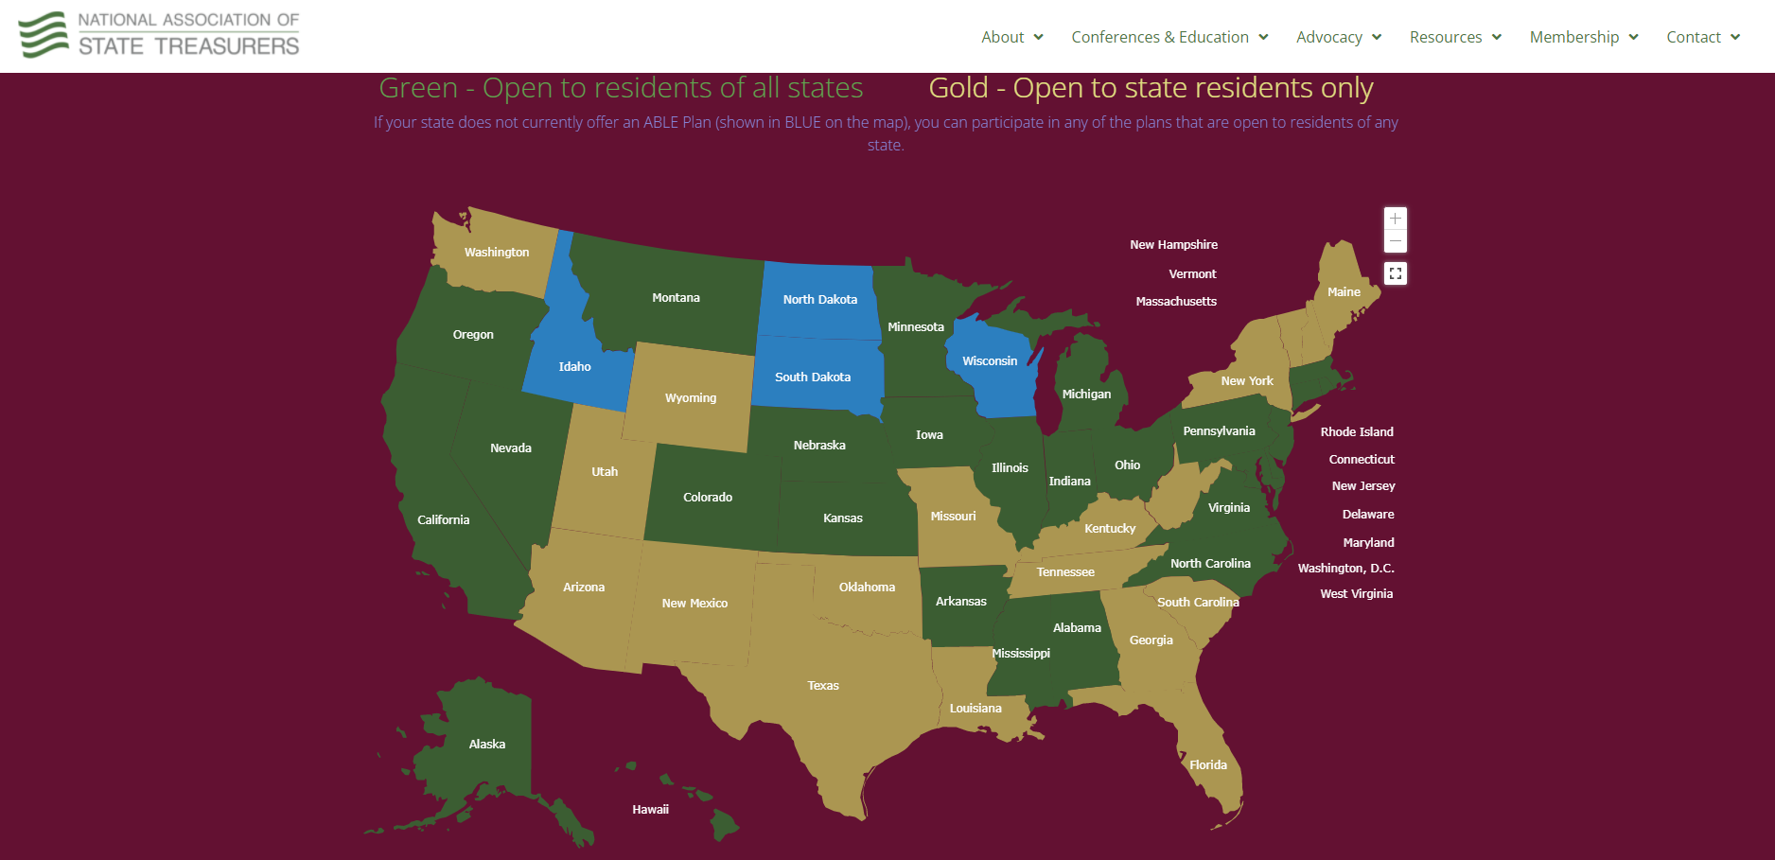
ABLE Programs Nationwide
Notes:
LEAD: JOHN
46 states and DC offer 15 distinct plans. Several states are in a collaborative structure, Florida is one of 10 independent states.

Slide 6
ABLE Program Comparison
Similarities:
All states subject to federal law and regulations
Each state had to enact state legislation
Primarily, ABLE programs fall under each state's college savings program(s)
Online enrollment
Differences:
Fees, fees, fees
National or state residents only
Investment lineup
Records administrator
Medicaid Recovery
Notes:
LEAD: JOHN
Understanding that there are other ABLE programs available nationwide, I like to give a little bit of perspective of how they compare to one another.
Let’s first start with similarities:
All states are subject to federal law and regulations
Each state had to enact state legislation
Primarily ABLE programs fall under each state's college savings program(s) or their treasury department
And lastly, all enrollment is done online
Now let’s shift to the differences:
Fees, fees, fees – each state does it differently, and here in Florida, we are proud to have no fees associated with opening or managing an account
National or state residents only – here, states had the opportunity to choose which route to go, and in Florida, we chose to be a statewide program just for Floridians
Investment lineup – again, states have the opportunity to choose how they approach investments, and we’ll get into what is offered here to our account holders a little bit later
Records administrator – this means who manages the backend of the enrollment process and management of the account and investments; in Florida, we partner with Sumday Administration which is owned by the BNY Mellon, one of the world’s largest financial institutions.

Slide 7
ABLE Status
ABLE United as of May 15, 2023
  Current Enrollment: 11,155 (9,852 active)
  Current Assets Under Management: $73.2 Million
National ABLE Enrollment as of March 2023
  Over 144,00 ABLE accounts
  $1.39 Billion in assets under management

Slide 8
Program Management for Florida
Notes:
LEAD: Steph
Now, let’s shift to look specifically at program management for the state of Florida.

Slide 9


The Florida ABLE Act
In July 2015, the State of Florida created ABLE United, a registered not-for-profit and direct support organization of the Florida Prepaid College Board (Florida Statutes Section 1009.986 - 1009.988). One year later, July 1, 2016, the program officially launched.
Notes:
LEAD: Steph
In July 2015, the State of Florida created Florida ABLE, Inc. (d/b/a ABLE United) a registered not-for-profit and direct support organization of the Florida Prepaid College Board to administer the ABLE United Program.​
​
Our mission is to encourage and assist the saving of private funds to help persons with disabilities cover costs that support their health, independence and quality of life.​
​
Some of you may be familiar with Florida Prepaid – which provides an affordable means for families to save for their children’s future college education. The first Florida Prepaid College Plans were sold in 1988, and since then, the organization that has helped more than a million families save. In total, they manage over $12 billion in investments.​ 4 days left in OE!
​
You’ll note here that our Board of Directors are comprised of the Florida Prepaid chairman, a vice chair that Florida Prepaid appoints, as well as appointees from the Governor, Senate President and Speaker of the House. Most notably, our board includes Congressman Ander Crenshaw from Jacksonville who played a critical role in the passage of the ABLE Act.

Slide 10
Benefits of ABLE Accounts
Ownership
Financial Flexibility
Tax Benefits
Generally, doesn’t count as a resource for SSI and Medicaid. Use it now or later.
Family, friends, and trusts may contribute, and generally doesn’t count as income to the beneficiary.
Account is owned by the individual with a disability; but others can assist in managing.
Tax-free growth; can be used for a variety of expenses including housing/food without impact to SSI.
Notes:
LEAD: Steph
When it comes to ABLE accounts, there are three key benefits, including:
Ownership
Financial Flexibility
Tax Benefits
We’ll get into each of these benefits as the presentation progresses.

Slide 11


Notes:
LEAD: Steph
Now that we’ve covered some of the basics on how ABLE came to be, I love sharing some stories about our account holders.
Our first picture is of Jenn Sikora and her son, Sean, who has Down syndrome. Jenn is a founding member of the ABLE Act and an ABLE United Ambassador - more than a decade ago, a group of parents gathered around a kitchen table to have a conversation about saving for their disabled children’s future. How could they save for their child with a disability just like their children without a disability? For far too long, individuals receiving benefits were forced to adopt the “spend versus save” mentality – so in an effort to provide increased opportunity for this community – the ABLE Act was born.
Our picture here is Alicia, who opened an ABLE United account to save for a wheelchair accessible van.
And Elliott with his Mom, Sandi, who has started saving for financial independence with the help of family, friends and the income he receives from his job as a DJ.

Slide 12
Eligibility
Notes:
LEAD: Steph
So, now that you’ve met some of our account holders, let’s discuss who is eligible for an ABLE account wil

Slide 13
Eligible individuals are allowed one ABLE account nationwide and must also:
Be a Florida resident (ABLE United specific)
Have a disability with onset prior to age 26 (age 46 starting in 2026)
Receive SSI, SSDI or self-certify the beneficiary has a disability that is “severe”
If selecting self-certify as an option, the individual must:
Have a diagnosis of a physical or mental impairment prior to age 26
Have a disability that is “marked and severe with functional limitations”
Have a disability that is expected to last for at least 12 months
Notes:
LEAD: Steph
Eligible individuals must meet three eligibility requirements:
First, the individual with a disability must be a Florida resident at the time of enrollment.
Second, the individual’s disability had to have an onset prior to age 26. age 46 starting in 2026
And third, the individual must be receiving SSI or SSDI and have a disability that is marked as “severe”
Those not receiving SSI or SSDI, then self-certify is an option, and that individual must:
Have a diagnosis of a physical or mental impairment prior to age 26
Have a disability that is “marked and severe with functional limitations”
Have a disability expected to last for at least 12 months

Slide 14
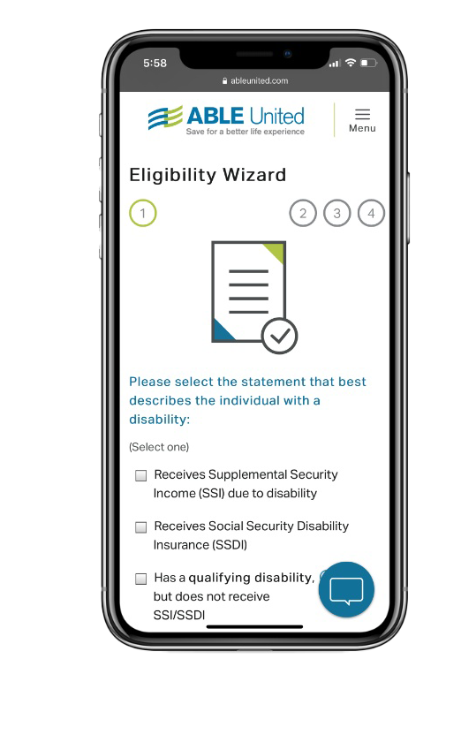
A qualifying disability includes individuals with a diagnosis such as:
Developmental Disorders: Autistic Spectrum Disorder, Asperger’s Disorder, developmental delays and learning disabilities
Intellectual Disability: Mild, moderate, or severe intellectual disability
Psychiatric Disorders: Schizophrenia, Major depressive disorder, Post-Traumatic Stress Disorder (PTSD), Anorexia Nervosa, Attention Deficit/Hyperactivity Disorder (AD/HD), Bipolar Disorder
Nervous Disorders: Blindness, Deafness, Cerebral Palsy, Muscular Dystrophy, Spina Bifida, Juvenile-onset Huntington’s Disease, Multiple Sclerosis, Severe sensorineural hearing loss, Congenital cataracts
Congenital Anomalies: Chromosomal abnormalities, including Down Syndrome, Osteogenesis Imperfecta, Xeroderma Pigmentosum, Spinal muscular atrophy, Fragile X Syndrome, Edwards Syndrome
Respiratory Disorders: Cystic Fibrosis
Other: Tetralogy of Fallot, Hypoplastic left heart syndrome, End-stage liver disease, Juvenile-onset rheumatoid arthritis, Sickle cell disease, Hemophilia, and any other disability not listed
Notes:
LEAD: Steph
But what does “severe” mean?
Ultimately, a qualifying disability is everything you see here – and it includes individuals with a diagnosis such as Down syndrome, autism, cerebral palsy, cognitive, developmental or mental health disorders.
If an individual is unsure if their disability qualifies, we recommend utilizing our online eligibility wizard.

Slide 15
Ownership
The individual with a disability, or the beneficiary, is the owner of the ABLE account – however, another person may assist in opening or maintaining the ABLE account as an authorized signatory, such as:
Legal Guardian
Power of Attorney
Parent, Spouse, Sibling, Grandparent
Representative Payee (Individual or Organization)
This authorized signatory is commonly referred to as the Authorized Legal Representative (ALR).
Notes:
LEAD: Steph
Here’s one of our key benefits.
When it comes to ownership, it’s important to note that unlike some other savings and investment options, the individual with the disability is the owner of the ABLE account – however, another person can help in opening and/or maintaining the account.
For a beneficiary who is over the age of 18, an Authorized Legal Representative or ALR can also help set up or maintain an account. An ALR is someone who is legally authorized under state and federal law to make decisions for the Beneficiary – if that is the case, additional paperwork will be required.
Recent IRS regulations have expanded who can serve in this role to a power of attorney, conservator or legal guardian, the spouse, a parent, a sibling, a grandparent, or a representative payee (whether an individual or organization) appointed by the Social Security Administration (SSA), in that order.

Slide 16
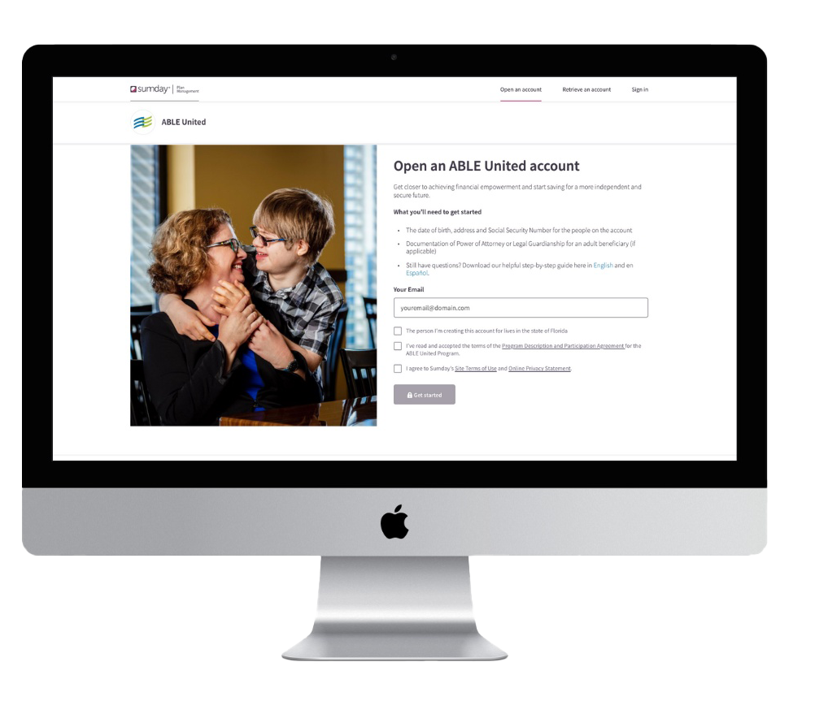
Here’s what you’ll need to open an account:
An email address
The date of birth, address and Social Security Number for the individuals on the account
Self-certification if opening on behalf of Beneficiary
Banking information credentials through Plaid
Minimum $25 contribution to the account
Investment selections
Notes:
Steph
Enrolling and managing an ABLE United account is all done online at ableunited.com – no need to go to the bank to setup an account. Signing up is quick, easy and free – it only takes 30 minutes or less.
Here’s what’s needed:
The date of birth, address and Social Security Number for the individuals (beneficiary and/or account administrator) on the account
Documentation of Power of Attorney or Legal Guardianship for an adult beneficiary over the age of 18
Banking information
A minimum $25 contribution to the account
Investment selections

Slide 17
Investment Options
Three predesigned portfolios to meet the needs of most investors or five individual funds to build a custom portfolio based on your goals:
Portfolio Options
Conservative
Moderate
Growth
Fund Options
Money Market Fund, Florida Prime
U.S. Stock Fund, Vanguard
U.S. Bond Fund, Vanguard
International Stock Fund, BlackRock
FDIC Savings Fund, BNY Mellon
Notes:
LEAD: Steph
ABLE United offers eight professionally managed investment options designed to meet unique savings goals. These include professionally designed portfolios with varying risk levels and individual fund options from which a custom portfolio may be built.
Our investment options were specifically designed to meet the needs of savers, beginning investors, and those with investment experience. Individuals can choose to select one or more of the eight options each time they contribute to their account, or they can just save in one. In other words, individuals can build their account their way – all while their earnings grow tax-free, so their money works harder for them!
Our portfolio options include: Conservative, Moderate and Growth.
And our five fund options include:
Money Market from Florida Prime;
U.S. Bond Fund from Vanguard;
U.S. Stock Fund from Vanguard;
International Stock Fund from BlackRock;
And, our newest offering, which is the FDIC Savings option.
The FDIC Savings Option is, of course, an alternative to investing. Assets up to $250,000 are protected and insured, but keep in mind that with a low level of risk, there’s also a lower level of returns.
As it pertains to investments, individuals can change how incoming contributions are invested at anytime and as frequent as they want. However, funds already invested in the program can only be rebalanced, or reinvested, twice a year.
We recently revamped our investment options page where individuals can find a solution to fit their needs and savings goals. All of our performance information is also available online at ableunited.com.

Slide 18
Contribute
Generally, contributions are considered gifts (not income) to the individual with a disability.
Contribution considerations include:
A total of $17,000 (2023) can be contributed per calendar year
ABLE to Work allows working beneficiary not saving for retirement can contribute above $17,000
  Compensation includible in the designated beneficiary's gross income for the taxable year, or
  An amount equal to the poverty line for a one-person household, as determined for the calendar year preceding the calendar year in which the taxable year begins (Florida = $13,590 (2023))
  Individual putting earned income into account, still counts as earned income
Opportunity to rollover funds from 529 college savings plan
Notes:
LEAD: Steph
After an account is opened, individuals can contribute what they can, when they can! The best part is, you can also save with the help of friends, family or even an organization, such as a church – up to $16,000 from all sources, per calendar year.
There is one exception – and that is if an individual is working.
Through ABLE to Work, beneficiaries who are working and not currently saving for retirement to contribute above $16,000 – that amount is equal to the poverty line for a one-person household, as determined for the calendar year preceding the calendar year in which the taxable year begins. This year, in Florida that total is $12,880, which allows an individual to save up to $28,880.
Individuals also have the opportunity to contribute to an ABLE account through the rollover of funds from 529 savings plans.
Lastly, there is no federal income tax-deduction for contributing to an ABLE account, so indidivuals can’t write contributions to your ABLE account off as a donation. Contributions are considered completed gifts and not income to the individual. Unless the individual is putting in their earned income or if it some kind of unearned income like child support.

Slide 19
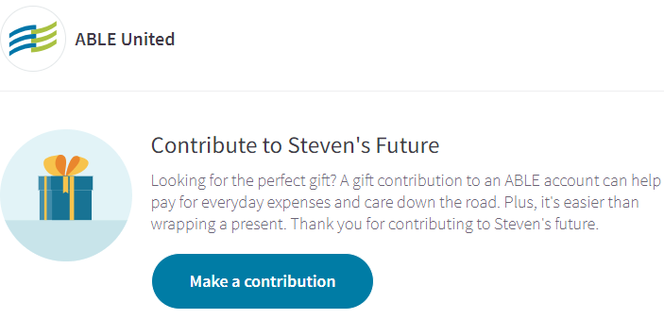
Notes:
LEAD: Steph
As I mentioned, it’s easy to save with the help of friends and family, especially now that we have enhanced our gifting page.
Account holders can use it like a GoFundMe page by setting a goal and sharing with individuals and/or organizations as a way for them to give gifts instead of physical presents for a birthday or holiday.

Slide 20
Withdraw
Withdrawal via electronic transfer to a connected bank, request for a check, or sign up for optional ABLE Visa® Prepaid Card.
Additional considerations:
Earnings are tax-free if withdrawals are used for Qualified Disability Expenses (QDE)
Choose which investment to withdraw from – allows to separate savings from investing
Keep documentation for the IRS and/or SSA
  Accounts receive 5498-QA showing ABLE account establishment and eligibility
  Account with a distribution receive 1099-QA showing total basis and earnings. No tax on earnings if used for QDE. If no QDE’s, tax on earnings portion + 10% penalty
The ABLE Visa® Prepaid Card is issued by Sunrise Banks N.A., St. Paul, MN 55103, Member FDIC, pursuant to a license from Visa U.S.A. Inc. This card can be used everywhere Visa debit cards are accepted. Use of this card constitutes acceptance of the terms and conditions stated in the Cardholder Agreement.
Notes:
LEAD: Steph
One of the best things about having an ABLE United account is its flexibility – money can be withdrawn from an account at any time, for any reason. Withdrawals may be made electronically, by check or with the ABLE prepaid card.
With the introduction of the new ABLE Visa® Prepaid Card, account holders can start swiping and instantly access funds to be used online, in stores – or anywhere nationwide that accepts Visa debit cards. Think of it as an ABLE United account on the go.
A few additional considerations:
If the money in an ABLE United Account is spent on Qualified Disability Expenses, as defined by federal law, the earnings on the money withdrawn are tax-free. We’ll cover qualified disability expenses on the new slide.
Individuals have the opportunity to choose which investment to withdraw from, which allows you to separate your savings from your investing.
If asked by the IRS or Social Security Administration, for those receiving SSI, the Beneficiary or Authorized Legal Representative is responsible for providing receipts for Qualified Disability Expenses. We always recommend that the individual or the person who is administratively responsible for the account keep necessary documentation on hand, so if asked, they could show that the expense relates to the person’s disability and helps improve their health, independence or quality of life.

Slide 21
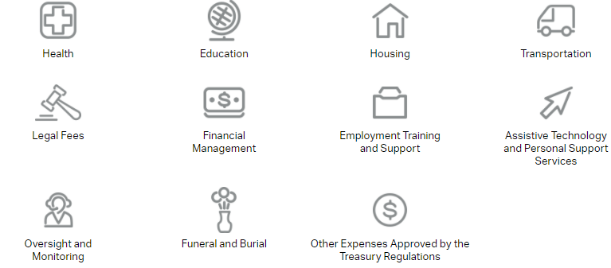
Qualified Disability Expenses
Notes:
LEAD: Steph
So, what are qualified disability expenses?
Some of these expenses include health, education, housing, transportation, legal fees, financial management, employment training and support, assistive technology and personal support services, oversight and monitoring, funeral and burial, and other expenses approved by Treasury regulations.

Slide 22
Qualified Disability Expenses
Therefore, the Treasury Department and the IRS cannot provide either a comprehensive list of qualified disability expenses or a short list of expenses that would not satisfy that standard. The Treasury Department and the IRS note that Congress did not define a qualified disability expense as any expenditure for the benefit of an eligible individual, nor did Congress define a qualified disability expense as an expense that benefits only the eligible individual. The ABLE Act mandates different tax treatment for those expenses that are qualified disability expenses and those that are not. Consequently, the final regulations retain the 2015 proposed regulations' broad, but not unlimited, definition of a qualified disability expense.
For more information, visit www.federalregister.gov/d/2020-22144/p-155.
Generally, if expenses relate to the Beneficiary and helps maintain or improve their health, independence, or quality of life, it can be considered a Qualified Disability Expense. The IRS or SSA typically would agree that alcohol, tobacco, gambling, anything illegal in nature and using the funds for the benefit of others (i.e., gifts) would not be qualified.
Notes:
LEAD: Steph
Qualified Disability Expenses include basic living expenses and are not limited to items for which there is a medical necessity, or which solely benefit the Beneficiary. Ultimately, it was written to be construed very broadly - as long as the expense relates to the Beneficiary and helps maintain or improve their health, independence, or quality of life, it can be considered a Qualified Disability Expense.
However, one caveat here, if an expense is not a qualified disability expense, the funds spent are subject to tax plus a 10 percent penalty on the earnings. That includes alcohol, tobacco, gambling and giving the funds away.
Explain IRS vs SSA reviewing expenditures
SSI reviews monthly, retaining funds past the end of the month – what are the plans for the funds?

Slide 23
Costs Associated
Best Value for Floridians
Generally, there are no fees associated with opening an account:
Investment administration fee ranges from 0.00% to 0.290% (annualized) of the account balance
  FDIC investment option has no fees
Optional $10.00 annual fee for paper statements
Optional ABLE Visa® Prepaid Card $2.50 per month
ABLE United offers the best value for Florida residents
No application fee
No monthly account maintenance fee
No paper check request fee
Program administered by Florida Prepaid
Notes:
LEAD: Steph
Now, let’s move on to costs associated with opening and managing an account. We get asked this question a lot – and the answer is that it’s free.
There is no:
Application fee
Account maintenance fee
All you have to do is to put in a minimum contribution of $25 to get started and let your money make money for you.
There are some optional fees associated with paper statements, the prepaid card and investment administration fees that range from 0 to .29 percent annually.
We are proud to provide the best value for Floridians and are one if not the only program that has no fees associated with opening and managing an account.

Slide 24
Public Benefits
Notes:
LEAD: JOHN
Now let’s pivot and talk about the specifics on how an ABLE account works with public benefits.

Slide 25
Specifics on Medicaid
Medicaid is a federal and state program that helps with medical costs for some people with limited income and resources. Florida has Home and Community Based Care Service Waivers, such as the iBudget and Long-Term Care, that provide a robust set of services and supports to those with significant disabilities.
Funds in (or withdrawn from) an ABLE account are disregarded as a resource (asset) when determining eligibility for Medicaid.
Recent Florida law states Medicaid may not file a claim on an ABLE account.
Generally, after all outstanding qualified disability expenses have been paid, leftover funds go to the beneficiary’s estate.
Notes:
LEAD: JOHN
Let’s first discuss Medicaid.
Medicaid is a federal and state program that helps with medical costs for some people with limited income and resources.
There is also Medicaid iBudget Waiver, which provides home and community-based supports and services to eligible persons with developmental disabilities living at home or in a home-like setting, utilize an individual budgeting approach, and provide enhanced opportunities for self-determination.
When it comes to ABLE accounts, funds in, or withdrawn from, an account are disregarded when determining eligibility for Medicaid.
One important thing to note is that in June 2019, the Florida Legislature clarified that the Florida Medicaid program may not file a claim for Medicaid recovery of funds in an ABLE United Account. Now, upon the death of a designated Beneficiary, funds in the ABLE Account must first be distributed for Qualified Disability Expenses, then transferred to the estate of the designated Beneficiary.
But I will share that Medicaid Estate Recovery does exist for those 55 and over – and meet other types of qualifiers.

Slide 26
Specifics on Supplemental Security Income (SSI)
Supplemental Security Income (SSI) is a Federal supplement program that provides cash to meet basic needs for food, clothing, and shelter.
Generally, funds in (or withdrawn from) an ABLE account are disregarded when determining eligibility for SSI.
  First $100,000 in ABLE account does not count as a resource.
  All housing and non-qualified expenses withdrawn, but not spent in the same month, count as a resource at the first of the following month. Includes prepaid card balance.
Program submits all account information to Social Security monthly to review SSI account holders who have ABLE accounts.
For more information, review the Social Security POMS: http://policy.ssa.gov/poms.nsf/lnx/0501130740
Notes:
LEAD: JOHN
Now let’s shift to SSI.
Supplemental Security Income (SSI) is a Federal supplement program that provides cash to meet basic needs for food, clothing, and shelter.
Like Medicaid, SSI has a resource limit of $2,000 and generally, funds in, or withdrawn from, an ABLE account are disregarded when determining eligibility.
It’s important to know that when it comes to ABLE accounts, individuals receiving SSI are able to save a total of $100,000 before it counts as a resource. For those not on SSI, there is a maximum balance of $418,000 for each ABLE United Account.
The social security administration has a program operations manual system, also known as POMS, that they use to describe how social security should handle ABLE accounts – if you or your loved one are receiving these benefits, we recommend you review the manual.

Slide 27
ABLE Accounts and SSI Example
Amy takes a distribution of $500 from her ABLE account in May to pay a housing expense for June. She deposits the $500 into her checking account in May, withdraws $500 in cash on June 3, and pays her landlord.
This distribution is a housing expense and part of her checking account balance as of June 1, which makes it a countable resource for the month of June.
How to avoid In-Kind Support and Maintenance Reduction
Have ABLE account pay housing directly
Withdrawal and pay housing same month
Notes:
LEAD: JOHN
On the topic of SSI, it’s important to know that all housing and non-qualified expenses withdrawn, but not spent in the same month, count as a resource.
Let’s walk through an example:
Amy takes a distribution of $500 from her ABLE account in May to pay a housing expense for June. She deposits the $500 into her checking account in May, withdraws $500 in cash on June 3, and pays her landlord.
This distribution is a housing expense and part of her checking account balance as of June 1, which makes it a countable resource for the month of June.
For individuals looking for a bit of a workaround, we recommend setting up the ABLE account to pay housing directly or simply withdrawal and pay housing same month.

Slide 28
ABLE Accounts and SSI Example
Paul is the designated beneficiary of an ABLE account with a balance of $101,000 on the first of the month. Paul's only other countable resource is a checking account with a balance of $1,500. Paul’s countable resources are $2,500 and therefore exceed the SSI resource limit.
However, since Paul's ABLE account balance causes him to exceed the resource limit (i.e., his countable resources other than the ABLE account are less than $2,000), Paul’s SSI eligibility is suspended and his cash benefits are stopped, but he retains eligibility for Medicaid in his State.
Considerations:
Contributions are limited to $16,000 a year
Monitor if close to $100,000 and beneficiary wants to maintain SSI
Notes:
LEAD: JOHN
Our next example is about Paul.
Paul is the designated beneficiary of an ABLE account with a balance of $101,000 on the first of the month. Paul's only other countable resource is a checking account with a balance of $1,500. Paul’s countable resources are $2,500 and therefore exceed the SSI resource limit.
However, since Paul's ABLE account balance causes him to exceed the resource limit (i.e., his countable resources other than the ABLE account are less than $2,000), Paul’s SSI eligibility is suspended and his cash benefits are stopped, but he retains eligibility for Medicaid in his State.
Important considerations here are that:
Contributions are limited to $15,000 a year
And it’s important to monitor if close to $100,000 and the beneficiary wants to maintain SSI

Slide 29
Other Federally Means Tested Programs
Per section 103(a) of the Tax Increase Prevention Act of 2014, titled Account Funds Disregarded for Purposes of Certain Other Means-Tested Federal Programs:
“Notwithstanding any other provision of Federal law…for the purpose of determining eligibility to receive…any assistance or benefit authorized by such provision…any amount (including earnings thereon) in the ABLE account…of such individual, any contributions to the ABLE account of the individual, and any distribution for qualified disability expenses…shall be disregarded for such purpose with respect to any period during which such individual maintains, makes contributions to, or receives distributions from such ABLE account….”
Notes:
LEAD: JOHN
Now, let’s quickly cover other federally means test programs as outlined by the Tax Increase Prevention Act of 2014, titled Account Funds Disregarded for Purposes of Certain Other Means-Tested Federal Programs.

Slide 30
Other Federally Means Tested Programs
Centers for Medicare & Medicaid Services
Released letter confirming “…. Funds in an ABLE account, including earnings on the account (e.g., interest), be disregarded in determining eligibility for Medicaid and other federal need-based programs.”
Left Medicaid recovery up to states “If the estate of an ABLE account beneficiary is not subject to Medicaid estate recovery, states have discretion whether to file a section 529A claim against the ABLE account of a deceased individual who had been enrolled in a Medicaid Buy In program.”
Notes:
LEAD: JOHN
First up – Medicaid, which we covered earlier, but two things to note:
Centers for Medicare & Medicaid Services released a letter confirm that funds in an ABLE account, including earnings on the account will be disregarded in determining eligibility for Medicaid and other federal need-based programs.
They also further clarified on Medicaid recovery and, ultimately, let that up to the states to decide.

Slide 31
Other Federally Means Tested Programs
United States Department of Agriculture – Supplemental Nutrition Assistance Program (SNAP)
SNAP is a means-tested Federal program, the Food and Nutrition Service (FNS) has determined that funds in ABLE accounts should be excluded as both income and resources in determining SNAP eligibility based on this provision. SSI version is referred to as SUNCAP.
United States Department of Housing and Urban Development
Notice PIH 2019-09: Treatment of ABLE Accounts in HUD-Assisted Programs states: Per the mandate of the ABLE Act, for the purpose of determining eligibility and continued occupancy, HUD will disregard amounts in the designated beneficiary’s/individual’s ABLE account.
Notes:
LEAD: JOHN
Here you’ll note that by Supplemental Nutrition Assistance Program, or SNAP, as well as United States Department of Housing and Urban Development, have also released letters denoting that they will disregard amounts in the designated beneficiary’s/individual’s ABLE account when determining eligibility.

Slide 32
Other Federally Means Tested Programs
United States Department of Education
The Free Application for Federal Student Aid (FAFSA) highlights that ABLE Accounts are not included when assessing assets.
Notes:
LEAD: JOHN
And, lastly, while nothing official has been stated, statutory framework of the ABLE accounts make it clear that Congress intended to exclude ABLE from consideration in federal means-tested programs, like financial aid.

Slide 33
ABLE and Special Needs Trusts
Notes:
LEAD: JOHN
SNT poll

Slide 34
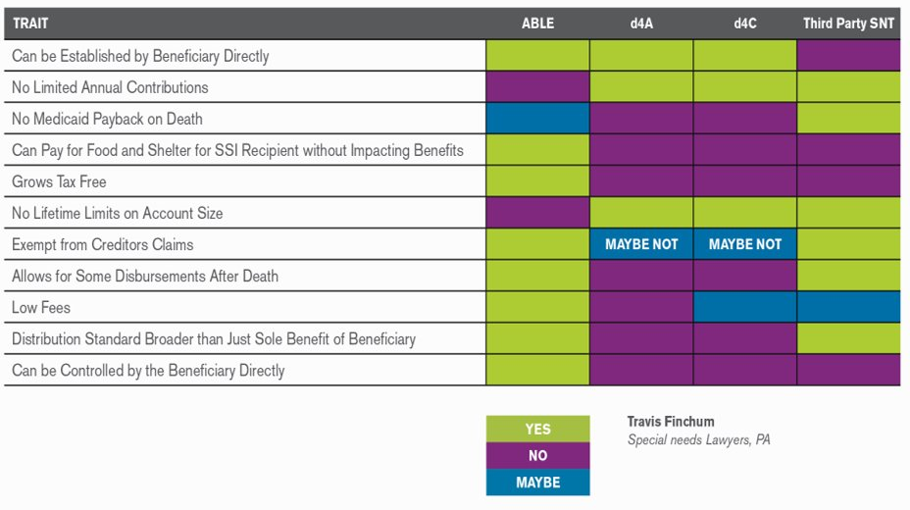
ABLE Accounts are NOT Special Needs Trusts
Special Needs Trusts are found under 45 U.S. Code §1396 p(d)(4) (Social Security Act)
ABLE Accounts are found in the Internal 26 U.S. Code §529A – Qualified ABLE Programs
Notes:
LEAD: JOHN

Slide 35
First Party Special Needs Trusts (Self Settled)
(d)(4)(A) – Under Age 65 Disability SNT
  Funded with beneficiaries' money: Unplanned Inheritance, Personal Injury Award, etc.
(d)(4)(B) – Qualified Income SNT
  Allows beneficiary to earn above public benefit threshold
(d)(4)(C) – Pooled SNT
  Combined funds with similarly situated individuals (pooling), reduce costs; administered by non-profit organization
Mandatory Medicaid payback on death of the beneficiary before residual beneficiaries
Notes:
LEAD: JOHN

Slide 36
Third Party Special Needs Trusts
Set up by someone else (family/friend) for the benefit for the person with a disability
Can be funded post death or can be funded now
Specific to each beneficiary
No Medicaid pay-back – can go to a different beneficiary or other family members
Notes:
LEAD: JOHN

Slide 37
Special Needs Trust
ABLE Accounts
Can be used to fund ABLE accounts, depends on trust documents
Part of estate planning
Can accept non-cash assets such as life insurance, homes and other assets
Requires attorney to set up / trustee to oversee
Can be costly
Provision to allow trustee to fund ABLE account
Flexible – can be used to pay for food and shelter for SSI recipient without impacting benefits (no ISM reduction)
Grows tax-free
Free online enrollment
Can be administered by individual or third party
Restricted to $17,000 in contributions per calendar year – but comingled funds
Protection against creditors
F.S. § 1009.986(6) and F.S. § 222.22(5)
Notes:
LEAD: JOHN

Slide 38
Death of Beneficiary
Notes:
LEAD: JOHN

Slide 39
Florida ABLE Statute
Section 1009.986(7), Florida Statute
(7) MEDICAID RECOVERY; PRIORITY OF DISTRIBUTIONS.—
(a) Unless prohibited by federal law, upon the death of a designated beneficiary, funds in the ABLE account must first be distributed for qualified disability expenses then transferred to the estate of the designated beneficiary or an ABLE account of another eligible individual specified by the designated beneficiary or by the estate of the designated beneficiary.
(b) Except as required by federal law, the state Medicaid program may not file a claim for Medicaid recovery of funds in an ABLE account.
(c) Florida ABLE, Inc., shall assist and cooperate with the Agency for Health Care Administration and Medicaid programs in other states by providing the agency and programs with the information needed to accomplish the purpose and objective of this subsection.
Notes:
LEAD: JOHN

Slide 40
Final Regulations – Successor Designated Beneficiary
The Treasury Department and the IRS recognize the difficulties faced by the family, friends, and caregivers of a designated beneficiary at the end of the designated beneficiary's life. In order to alleviate some of these difficulties, the final regulations allow a qualified ABLE program to permit a successor designated beneficiary to be named during the lifetime of the designated beneficiary that will take effect upon the death of the designated beneficiary. The designation must be made before the designated beneficiary's death. If no successor designated beneficiary is named, the assets in the ABLE account are payable to the estate of the deceased designated beneficiary. Before any transfer to the successor designated beneficiary, however, the ABLE account is subject to the Federal estate tax imposed by chapter 11 of the Code upon the estate of the deceased designated beneficiary, as well as to the payment of any outstanding qualified disability expenses of the decedent and any State claim under section 529A(f).
https://www.federalregister.gov/d/2020-22144/p-172
Notes:
LEAD: JOHN

Slide 41
Final Regulations – Medicaid Repayment From Other States
Consistent with section 529A, the final regulations provide that a qualified ABLE program may satisfy a State's Medicaid reimbursement claim only after providing for the payment of any outstanding qualified disability expenses of the deceased designated beneficiary, including the designated beneficiary's funeral and burial expenses, whether or not the subject of a pre-death contract for those services. The final regulations do not impose an obligation on the qualified ABLE program to verify the validity or accuracy of a State's Medicaid reimbursement claim. However, as noted previously, the payment of any claim is limited to the amount of total medical assistance paid for the designated beneficiary after the establishment of the ABLE account, net of any premiums paid (whether from the ABLE account or otherwise by or on behalf of the designated beneficiary) to a State Medicaid Buy-In program. In addition, no obligation is imposed on the qualified ABLE program to determine whether claims could be filed by multiple States. After the expiration of the applicable statute of limitations for filing Medicaid claims against the designated beneficiary's estate, a qualified ABLE program may distribute the balance of the ABLE account to the successor designated beneficiary or, if none, to the deceased designated beneficiary's estate.
https://www.federalregister.gov/d/2020-22144/p-182
Notes:
LEAD: JOHN
Typically, post death funds are distributed based on direction from the personal representative or ALR. It would be up to the estate to pay for outstanding Medicaid claims if applicable. How long should funds remain in the account before they may be paid to an estate. Process of estates may take a year or longer.
Where bene has lived previously / what should they do

Slide 42
Current Practice
Account continues to operate as normal until the Program is notified about a death of beneficiary; once notified, the account is frozen to prevent contributions
If the ABLE account currently has an Authorized Legal Representative:
  Funds may be requested to withdrawn to pay for outstanding qualified disability expenses including funeral/burial, outstanding bills including housing, credit card bills, etc.
  If funds remain, “a Certification will be required stating that the person is: (1) the executor of the Beneficiary’s estate as defined in Section 2203 of the Code; and (2) responsible for the proper disposition of the Account Balance” – ABLE Terms & Conditions Section 8.02 (d)
  OR Funds go to the successor designated beneficiary setup prior to death (must be sibling who qualifies for an ABLE Account)
If the ABLE account does not have an Authorized Legal Representative:
  Typically, a death of beneficiary form with death certificate and documentation on who is serving as the personal representative of deceased beneficiary’s estate is required
    Personal representative may use funds to pay outstanding qualified disability expenses
  If funds remain, same process as above
Notes:
LEAD: JOHN

Slide 43
Hypothetical Situations
Notes:
LEAD: JOHN
Before I open it up to questions, I want to spend a few minutes covering some of our frequently asked questions.

Slide 44
35-year-old female with Spina Bifida receives a small, one-time inheritance or personal injury award and is currently receiving Medicaid funding
Put the remainder, after spend-down plan, into an ABLE Account. May need to be split over two calendar years maxing ABLE account contribution limit each year.

Slide 45
51-year-old male with Down syndrome lives in Florida and has a Florida Guardian, but has siblings and family across the country that want to help pay housing expenses
Guardian establishes and ABLE Account and provides ABLE Account number to siblings along with gifting form and a link to an online gifting page. Family contributes $2,000 a month. Guardians uses funds in the ABLE Account to pay for condo HOA dues, property tax, monthly utility bill, and a portion of the rent. Since ABLE Account is paying for the housing related expenses directly, no impact to the individuals monthly SSI check.
However, if siblings paid directly, would cause In-kind Support and Maintenance (ISM) reduction, roughly $3,600 a year.

Slide 46
22-year-old recently diagnosed with Schizophrenia and Bipolar disorder started receiving SSI. SSA determined individual is incapable of managing their SSI payment. Representative Payee could establish this account on their behalf, however, someone else may be better suited.
ABLE Accounts can be managed by a hierarchy of individuals including: a guardian, power attorney, the spouse, a parent, a sibling, a grandparent, or a representative payee under Social Security Administration. Since the account is owned by the individual with a disability, they can still access the account by calling customer service, unless Program is aware that the individual has been adjudicated incompetent by court, not by SSA.
Friend can use a durable power of attorney, available at www.ableunited.com/power-of-attorney, to open an account on behalf of friend.
Notes:
John: Record keeping purposes for the most part. Only issue if someone receives two 5498s

Slide 47
Mom receives full custody of 8-year-old with Autistic Spectrum Disorder. Court ruled dad must pay monthly child support services.
ABLE Account could receive up to $1,333 a month into ABLE account with mom accessing the funds directly without having to go through a pooled trust or trustee. Note, although payment may be direct-deposited into an ABLE Account, these funds still would be counted as income for SSI purposes.
ABLE Accounts shelter assets not income.
Notes:
John: Record keeping purposes for the most part. Only issue if someone receives two 5498s

Slide 48
Mom and dad have a child with a severe intellectual disability and split custody between them. Dad resides in Pennsylvania and Mom resides in Florida. They would like to open an ABLE Account for their child. Which ABLE program is best suited for the family?
It is important to note each state may establish an ABLE Program. ABLE United is the state of Florida’s ABLE Program. Pennsylvania’s ABLE Program, PA ABLE, has state income tax incentives for contributing to a PA ABLE account. However, an individual may only have one ABLE account nationwide regardless of which program is chosen.
PA ABLE is open for nation wide enrollment, while ABLE United is restricted to Florida residents at time of application. It may be best to point individuals to national organizations to help identify what program is best suited for their unique needs, such as www.abletoday.org or www.ablenrc.org.
Notes:
John: Record keeping purposes for the most part. Only issue if someone receives two 5498s

Slide 49
How to Reach Us
Notes:
LEAD: RACHEL
At ABLE United, we are committed to ensuring individuals have what they need to open an account or help a loved one or someone they serve open an account.

Slide 50
How to Reach Us
Online
Visit us at ableunited.com
Spanish resources available at ableunited.com/espanol
Request Printed Materials
Check Events calendar for in-person, virtual events, and opportunity to book a one-on-one appointment
Phone
Monday – Friday, 9am – 6 pm ET
1-888-524-ABLE (2253)
711 Florida Relay
Notes:
There are several ways to reach us:
You can visit us online at ableunited.com where you can also put in a request to receive free printed materials.
You can navigate over to our Events calendar where we keep a running list of in-person and virtual events, as well as al opportunity to book a 1:1 appointment with John.
You can also reach us by phone to connect with a Customer Service Representative, Monday through Friday from 9am – 6pm ET

Slide 51
Thank you!
The information contained in this presentation is for general information purposes only and does not constitute tax, legal, financial or investment advice. Performance of the program discussed herein is not guaranteed and is subject to market conditions, among other things. Carefully consider objectives, risks, charges and expenses before investing. As with any investment, it is possible to lose money by investing in this program. Please read the Program Description and Participation Agreement carefully (www.ableuntied.com/pdpa).
Notes:
Until next time!

